Slide 1

IMAGE STEGANOGRAPHY
Mentor Name: Ashwini Kumar
Aish Goyal
2016596
Sec -F

Slide 2
INTRODUCTION
Image steganography is a method to hide data within the pixels of an image. It leverages human perception limitations to conceal data in a way that is difficult to detect. It can be used to hide sensitive or confidential data within an image file. By embedding the data in the image, steganography provides a covert communication channel, as the casual observer is typically unaware of the existence of the hidden message.
Every steganography consists of three components:
1. Cover object
2. Message object
3. Resulting Steganographic object

Slide 3
PROBLEM STATEMENT
Designing an Efficient and Secure Image Steganography Technique for Secure Communication
With the rapid advancement of digital communication, the need for secure and confidential data transfer has become increasingly crucial. Image steganography, the art of hiding secret information within digital images, offers a promising solution to achieve covert communication. However, existing image steganography techniques often suffer from limitations such as low embedding capacity, poor visual quality, vulnerability to detection, and inadequate security measures.
The aim of this research project is to develop an efficient and secure image steganography technique that addresses the shortcomings of current methods.

Slide 4
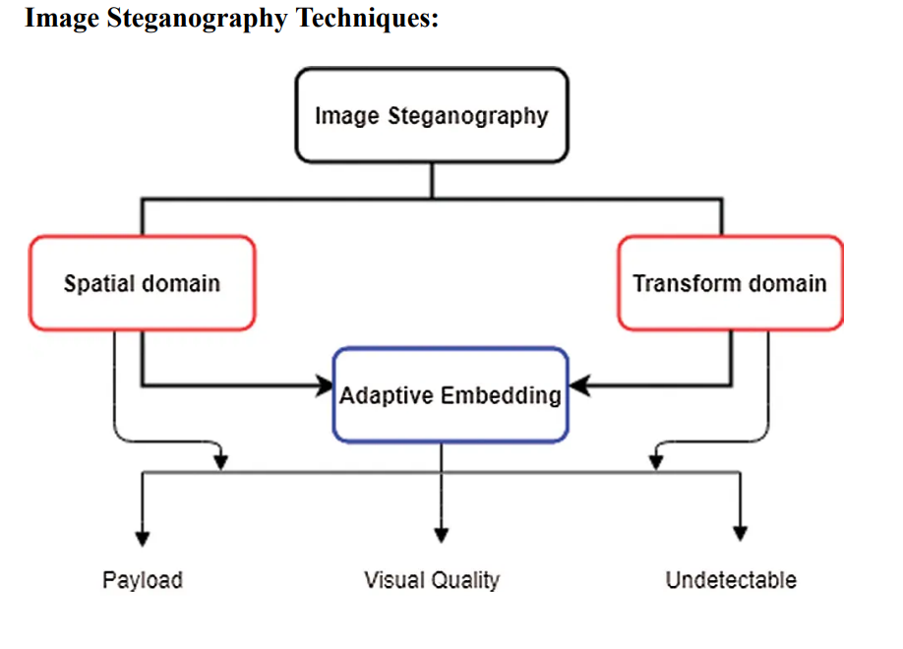

Slide 5
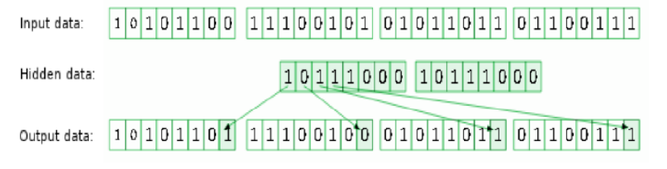
LSB Substitution
LSB substitution is one of the simplest and most commonly used techniques in image steganography. It involves replacing the least significant bit of the pixel values in the cover image with the bits of the secret message. The alteration of the LSB has minimal impact on the visual quality of the image, making it suitable for hiding information imperceptibly.

Slide 6
Methodology
1. Import the necessary libraries and load the cover image and the secret message.
2. Convert the cover image and the secret message into matrices of pixel values.
3. Ensure that the size of the secret message does not exceed the available space in the cover image.
4. Choose the LSB plane(s) to modify. The LSB of each pixel is typically used for embedding.
5. Encode the length of the secret message into the cover image. This will be used during extraction.
6. Iterate over the pixels of the cover image and modify the LSBs according to the secret message. - Extract a pixel from the cover image. - Extract the next bit of the secret message. - Modify the LSB of the pixel with the secret bit. - Replace the pixel in the cover image with the modified pixel.
7. Save the stego image (cover image with an embedded secret message) to a file.
8. To extract the secret message from the stego image: - Load the stego image. - Retrieve the length of the secret message from the LSBs of the pixels. - Extract the LSBs of the pixels to reconstruct the secret message.
9. Display or output the extracted secret message.

Slide 7
Result and Discussion
Picture steganography has been utilized covertly in fact transmission with the aim that facts may be transmitted in a stable and thriller way. Based on the photograph steganography technique thriller facts have been transformed into parallel association and that has been set up with pixel bits of the duvet photograph. On the basis of auditing unique photograph steganography tactics, we are able to presume that LSB primarily based totally and AI primarily based totally methodologies supply higher steganography as assessment with current methodologies. These methodologies have a great beneficial role in that those do now no longer impact the character of the photograph.

Slide 8
Conclusion and Future Work
Enhanced Security: Explore and implement advanced encryption techniques to further strengthen the security of the hidden data. You can research and integrate cryptographic algorithms like AES (Advanced Encryption Standard) or RSA (Rivest-Shamir-Adleman) for encrypting the secret information before embedding it in the image.
Multiple File Formats: Extend your project to support embedding and extraction of hidden data in various image file formats, such as JPEG, PNG, GIF, or BMP. Each file format has its own specifications and challenges, so implementing support for multiple formats can enhance the versatility of your steganography tool.3.
Audio and Video Steganography: Extend the capabilities of your project to include hiding data within audio files (audio steganography) and video files (video steganography). This expansion allows for hiding information in different types of multimedia, providing a more comprehensive steganography solution.

Slide 9
4. Error Correction Techniques: Investigate and implement error correction techniques to make the steganography process more robust against noise or intentional attacks. Error correction codes like Reed- Solomon or Hamming codes can help ensure the accuracy of the hidden data during extraction, even in the presence of disturbances.
5. Steganalysis Techniques: Research steganalysis techniques that aim to detect the presence of hidden data in images. By understanding the vulnerabilities and 12 weaknesses of steganography methods, you can develop countermeasures and improve the effectiveness of your steganographic algorithms.

